Slide 1
NIOHACK 2026
01
ROUND I SUBMISSION — TRACK 10 · OPEN INNOVATION
FINAI
AI Market Intelligence & Paper-Trading Behavioral Coach
Problem theme: retail traders lose to unmanaged psychology, not bad information.
Team Lead — Bhuvan Malhotra bhuvanmalhotra11@gmail.com · +91-7888307155
Team Hessonite
Thapar University

Slide 2
BACKGROUND & PROBLEM STATEMENT
02 / 13
Retail traders don't lose to bad information — they lose to unmanaged psychology.
9/10
The Behavioral Tax
The Education Gap
The Black Box Problem
Loss aversion, revenge trading, overconfidence, and the disposition effect drive the losses — not missing data.
Existing paper-trading apps only teach execution — how to press buttons — never how to manage psychology.
Existing AI finance tools act as crystal balls — buy/sell signals with no explanation of the mechanics or the user's own patterns.
retail F&O day traders lose money, per SEBI's own studies

Slide 3
OUR SOLUTION
03 / 13
THE BEHAVIORAL MIRROR
FinAI is an educational, two-sided AI platform that trains retail traders before they risk real capital.
SIDE ONE
SIDE TWO
Market Intelligence
The Behavioral Sandbox
A RAG-powered engine fusing live prices, fundamentals, and news into plain-language analysis.
A native paper-trading environment where users simulate trades against live market prices — zero capital at risk.
WHY IT TRANSFERS
"We are not building a crystal ball. We are building a behavioral mirror."
Loss aversion and the disposition effect are wired to the experience of loss itself, not the size of the capital — Phase 3 calibrates the same profile against real loss aversion.

Slide 4
NOVELTY
04 / 13
What No Existing Tool Does
VS. PAPER-TRADING APPS
VS. AI SIGNAL TOOLS
VS. ROBO-ADVISORS
Teach Psychology, Not Buttons
Cited, Not Opaque
Rupee ROI on Discipline
They simulate order execution. FinAI is the first to attach a behavioral-diagnostic layer to every simulated trade.
They output a buy/sell verdict with no reasoning. FinAI's Hybrid Architecture makes every nudge traceable to the user's own trade IDs — hallucination-structurally-prevented.
They manage a portfolio for the user. FinAI's Counterfactual Engine quantifies the exact cost of the user's own behavior in rupees.

Slide 5
SHOW STOPPER — FLAGSHIP FEATURE
05 / 13
The XAI Receipt, In Practice
RECEIPT — REVENGE_TRADING_HIGH_RISK
Actual P&L
−₹8,500
"Your last 3 losses in banking stocks ( View Trades: T-41, T-42, T-45 ) were entered within 20 minutes of a negative sentiment spike. Sentiment is currently negative. Consider a 20-minute cooling-off window."
With Cooling-Off (Counterfactual)
+₹14,200
One screen, entire thesis: transparent, cited to real trade IDs, and quantified in rupees — not an opaque buy/sell signal.

Slide 6
METHODOLOGY
06 / 13
Deterministic Math, Then Language
STEP 1 — CONTEXT SNAP
STEP 2 — TRIGGER
STEP 3 — GUARDRAIL
Feature Engine
Rule Evaluator
LLM Synthesis
Order ticket captures symbol/size/price; engine computes Z-scores & trade-frequency gaps.
Flags exact risk state (e.g. REVENGE_TRADING_HIGH_RISK), bound to trade IDs.
Claude turns the bound JSON payload into empathetic language — never invents facts, never says "buy/sell X."
1 Registration
→
2 Simulation
→
3 Data Capture
→
4 XAI Intervention
→
5 User Choice
<3 min
0
100%
LIVE DEMO LENGTH
REAL CAPITAL AT RISK
CITED, EXPLAINABLE OUTPUT

Slide 7
TECH STACK & BUDGET
07 / 13
Real-Time Data, Near-Zero Cost
LAYER
TECH
WHY
Frontend
Next.js + Recharts
Fast, chart-ready, broker-like UI
ESTIMATED BUILD BUDGET
Backend
TypeScript / Node.js
Type-safe real-time WebSocket streams
Market data (Fyers free tier)
₹0
Rule Engine
Python
Z-scores as strictly bound JSON payloads
Hosting (free-tier compute)
₹0
Database
PostgreSQL
Atomic trade logs, fast receipt queries
Managed Postgres (free tier)
₹0
AI Layer
Claude API
Grounded RAG + JSON-schema, education-only
Claude API (demo-scale usage)
~₹800
Total, hackathon MVP
~₹800
Market data: Fyers API (free real-time WebSocket) · Dhan / Angel One (fallback)
Every layer above is free-tier or usage-based — the MVP scales from hackathon demo to pilot without a re-architecture.
No paid infrastructure blocks the demo — every credential used today is a free developer tier.

Slide 8
EXPECTED OUTCOME
08 / 13
Learning & Discipline, Measured — Not Alpha
01
02
03
04
XAI Receipt Engagement — click-through on flagged historical trades
Cooling-Off Adoption Rate — accepted vs. forced trades
Post-Loss Trade Frequency — reduction within 30 min of a flagged loss
Activation Rate — users reaching the 6–7 trade threshold
Key risk mitigated
Next: Phase 2 Market Replay (historical volatility days), Phase 3 opt-in real broker linking via Kite Connect / Upstox to calibrate against genuine loss aversion.
hallucinated context is structurally prevented — the LLM only ever narrates the Python rule engine's bound JSON payload.
Now
Phase 2
Phase 3
COMPLIANCE — EDUCATION FIRST
HACKATHON MVP — LIVE
MARKET REPLAY
REAL BROKER LINKING
All trades are simulated — no real capital, no real exchange orders. FinAI sits outside SEBI's Investment-Adviser and algo-trading triggers by design.

Slide 9
TEAM & ROLES
09 / 13
Team Hessonite
TEAM LEAD
PRODUCT & FRONTEND
DATA & INFRASTRUCTURE
Nikhil Sharma
Vedant
Bhuvan
AI & Behavioral Systems
Next.js & Product Design
Backend & Market Data
Owns the Hybrid XAI Architecture — the deterministic feature engine, rule evaluator, and Claude synthesis layer that generates every Receipt.
Builds the order ticket, portfolio, and charting UI in Next.js + Recharts, and designs the Receipt / Counterfactual interaction itself.
Owns the Node.js backend, PostgreSQL schema, and the Fyers WebSocket integration streaming live prices into the sandbox.
Three roles, one architecture: the behavioral core, the interface that surfaces it, and the data pipeline that feeds both — built and demoable together for Round I.

Slide 10
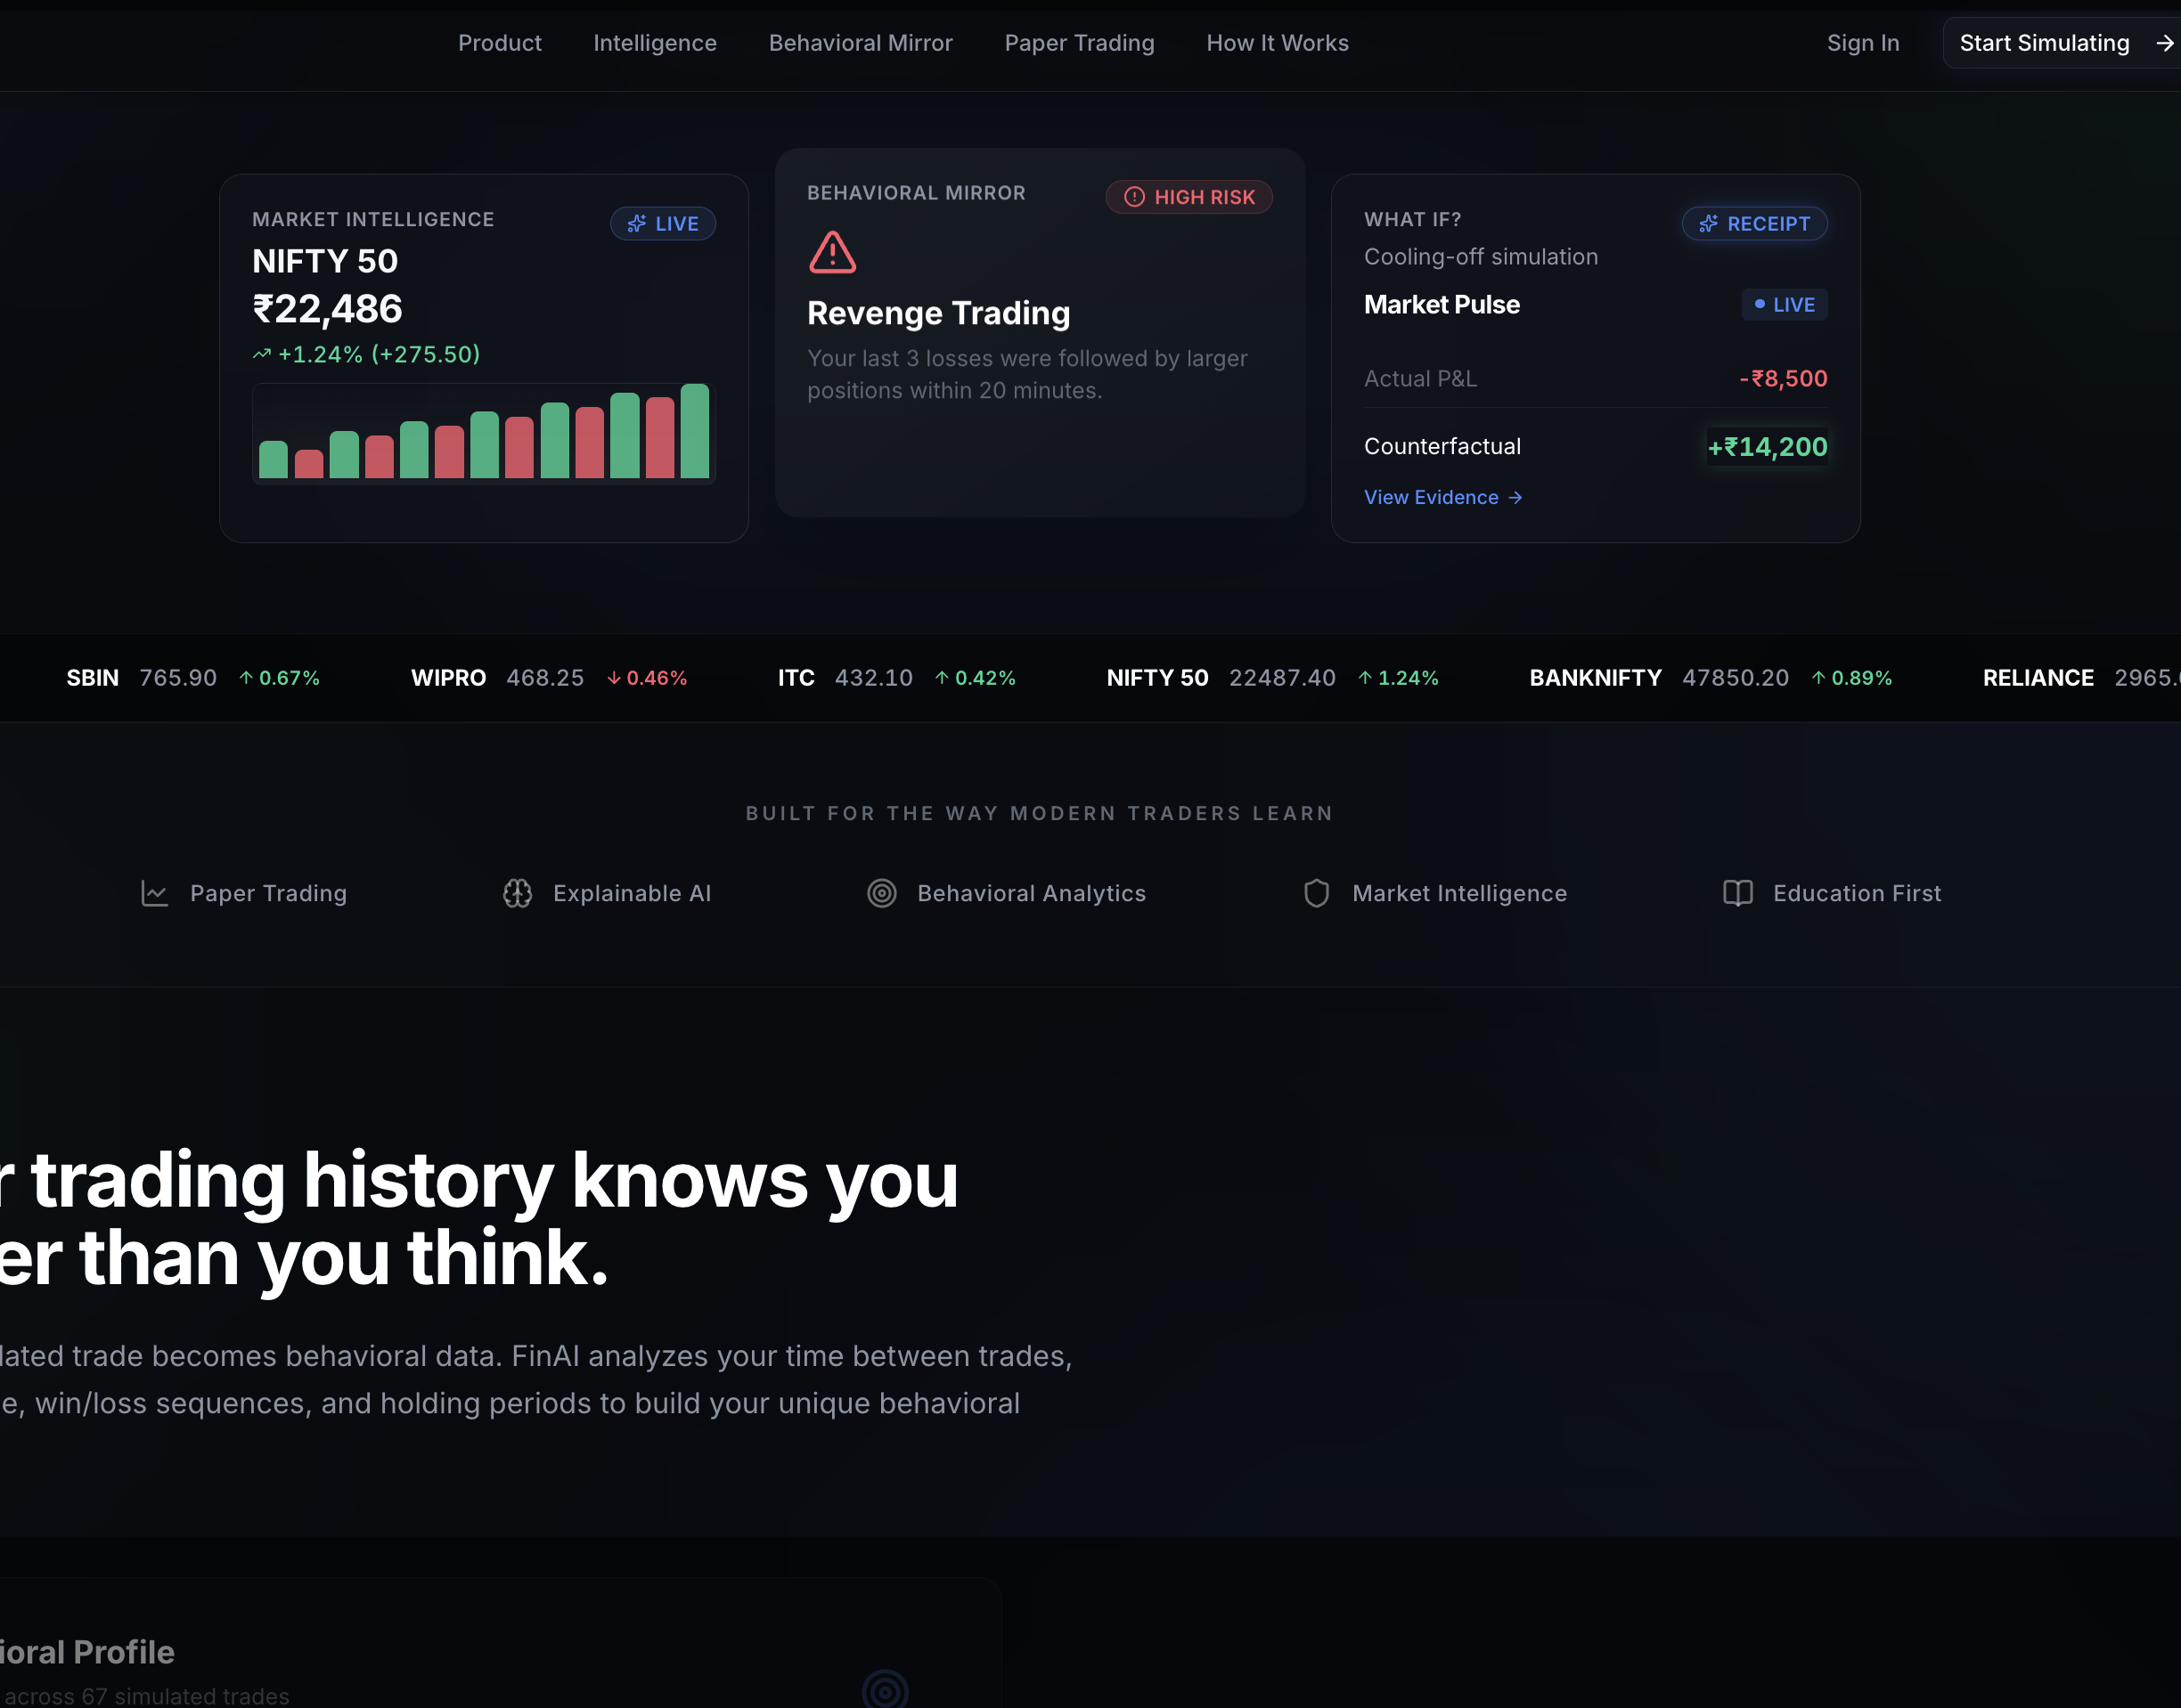
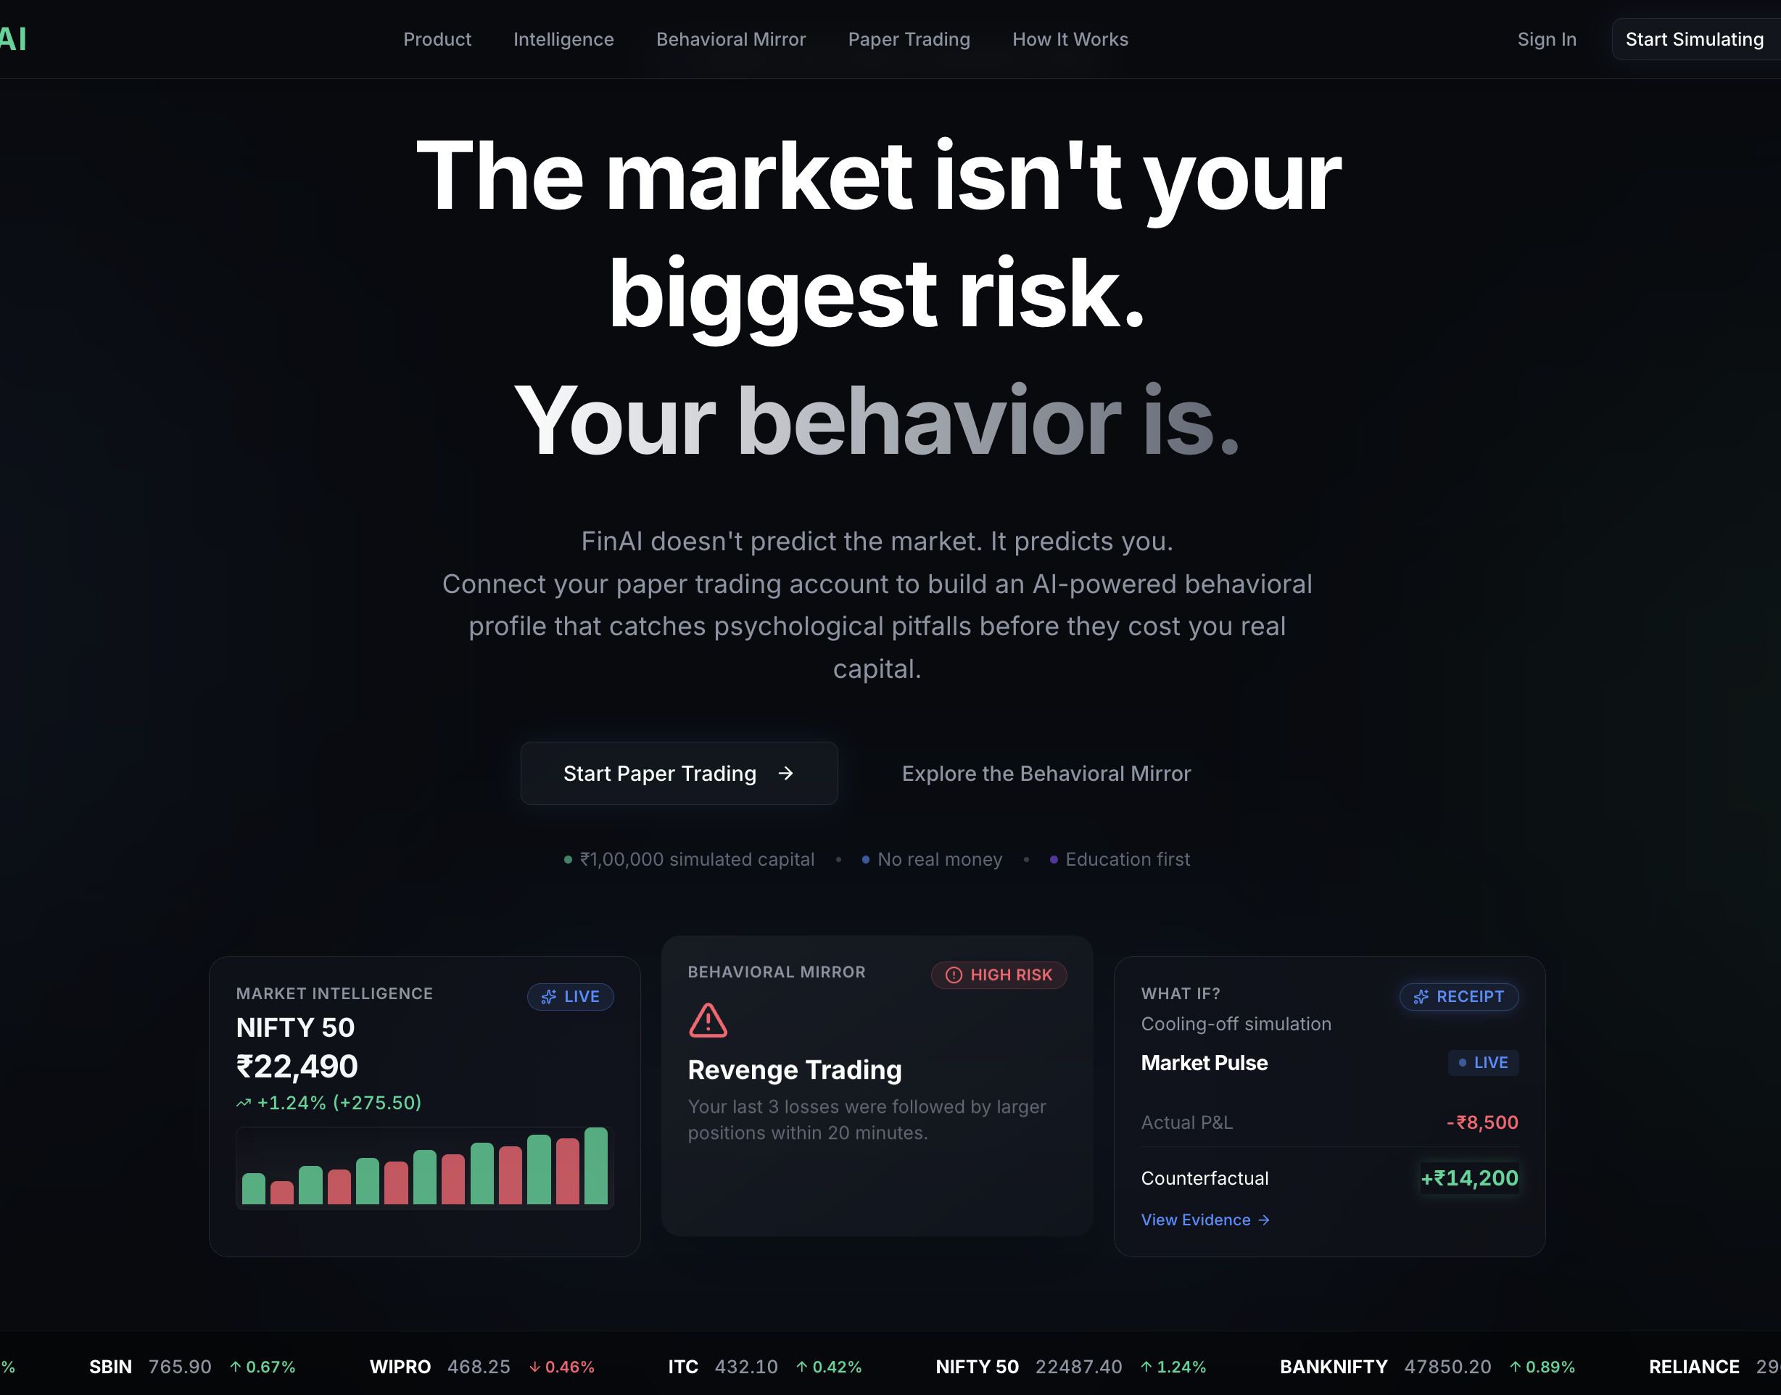
PRODUCT SCREENS
10 / 13
Inside the Sandbox
Landing Page — Behavioral-Mirror Positioning
How It Works — Connect, Simulate, Trade, Reflect

Slide 11
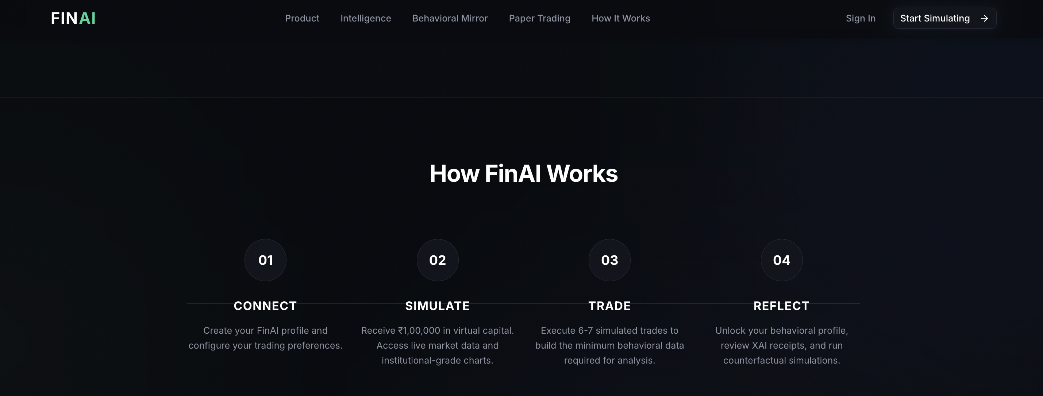
PRODUCT SCREENS
11 / 13
Market Intelligence & the Behavioral Mirror
Live Market Intelligence, Behavioral Mirror & What-If Counterfactual Cards

Slide 12
REFERENCES
12 / 13
References
[1]
SEBI, Study on Profitability of Individual Traders in Equity Futures & Options Segment, 2023 — basis for the "9 in 10" retail loss statistic.
[2]
Kahneman, D. & Tversky, A., Prospect Theory: An Analysis of Decision under Risk, Econometrica, 1979 — loss aversion.
[3]
Shefrin, H. & Statman, M., The Disposition to Sell Winners Too Early and Ride Losers Too Long, Journal of Finance, 1985.
[4]
Fyers API & Anthropic Claude API documentation — real-time market data and grounded RAG / structured-output generation.

Slide 13
NIOHACK 2026 — TEAM HESSONITE
Thank You
A hallucination-free, regulator-safe product that turns discipline into a measurable number.
Questions? bhuvanmalhotra11@gmail.com

